Slide 1

Limits on forecasting the trend, peak and the end of an expanding epidemic while the epidemic is still spreading
Anno Accademico 2019/2020
Manuel Lacal

Slide 2
Outline
SCIR: SIR model with confinement
Model description
Fitting COVID-19 data
Bayesian parametric model
Gibbs sampler algorithm
Fit results: Italy
First wave
Before peak → peak occurrence
Until peak → end epidemic occurrence
Second wave
Before peak → peak occurrence
Until peak → end epidemic occurrence
Fit results: other countries
Spain
France

Slide 3
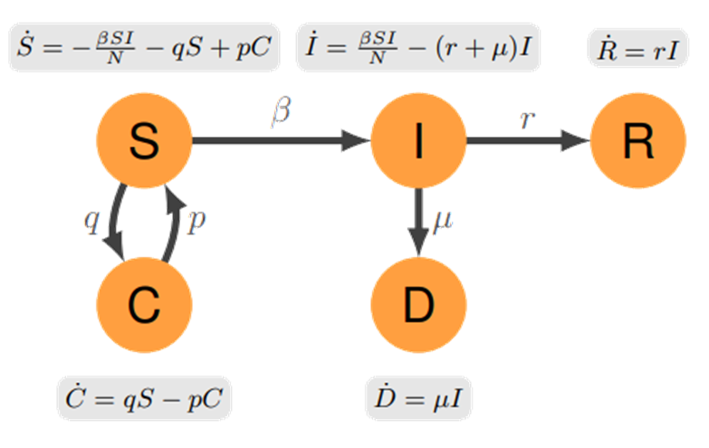
SCIR: SIR model with confinement
Compartments:
S: susceptible individuals
C: individuals sent to confinement
I: infected individuals
D: deaceased individuals
R: recovered individuals
Parameters:
N: total population
β: trasmission rate
µ: rate of death
r: recovery rate
p: rate of individuals that leave the confinement
measures (essential jobs, defection)
q: rate about specific measures restricting
mobility and contacts
Fit I to data on officially diagnosed cases, which are automatically quarantined: the underlying assumption is that the real, mostly undetected, number of infections is proportional to the diagnosed cases.

Slide 4
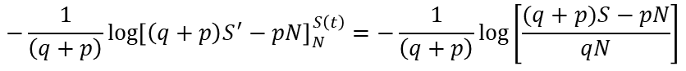
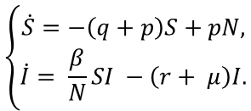
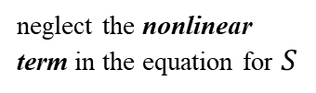
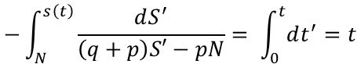
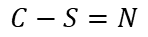
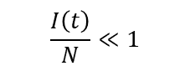
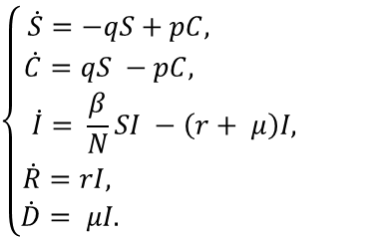
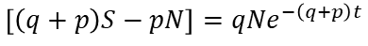
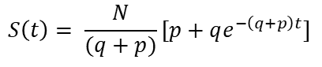
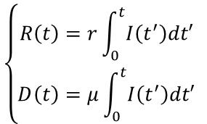
For sufficiently large population, the number of infected individuals at the initial stages of
the infection is well below the population size
$$\frac{I\left(t\right)}{N}≪1$$
neglect the nonlinear term in the equation for $S$
$$\left\{\begin{aligned}\dot{S}=−\left(q+p\right)S+pN, \\ \dot{I}= \frac{β}{N}SI −\left(r+ μ\right)I.\end{aligned}\right.$$
$$\left\{\begin{aligned}\dot{S}=−qS+pC, \\ \dot{C}=qS −pC, \\ \dot{I}= \frac{β}{N}SI −\left(r+ μ\right)I, \\ \dot{R}=rI, \\ \dot{D}= μI. \end{aligned}\right.$$
$$C−S=N$$
$$\left\{\begin{aligned}R\left(t\right)=r\int_{0}^{t}{I\left(t^{′}\right)dt′} \\ D\left(t\right)=μ\int_{0}^{t}{I\left(t^{′}\right)dt′} \end{aligned}\right.$$
Susceptibles equation solution:
$$−\int_{N}^{s\left(t\right)}{\frac{dS^{′}}{\left(q+p\right)S′−pN}}= \int_{0}^{t}{dt^{′}}=t$$
$$−\frac{1}{\left(q+p\right)}log{\left[\left(q+p\right)S^{′}−pN\right]}_{N}^{S\left(t\right)}=−\frac{1}{\left(q+p\right)}log⁡\left[\frac{(q+p)S−pN}{qN}\right]$$
$$S\left(t\right)= \frac{N}{(q+p)}[p+qe^{−\left(q+p\right)t}]$$
$$\left[\left(q+p\right)S−pN\right]=qNe^{−\left(q+p\right)t}$$

Slide 5
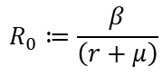
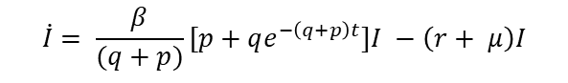
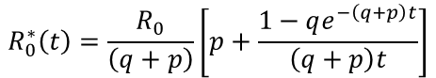
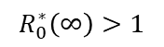
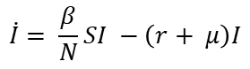
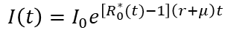
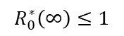
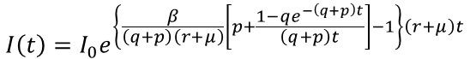
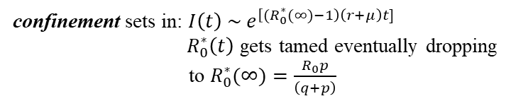
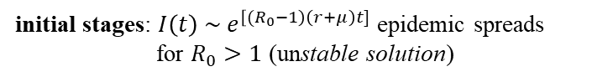
Infectious equation solution:
$$\dot{I}= \frac{β}{N}SI −\left(r+ μ\right)I$$
$$\dot{I}= \frac{β}{(q+p)}[p+qe^{−\left(q+p\right)t}]I −\left(r+ μ\right)I$$
$$log\left(\frac{I(t)}{I_{0}}\right)=\int_{I_{0}}^{I\left(t\right)}{\frac{dI^{′}}{I′}}= \int_{0}^{t}{\left[\frac{β}{(q+p)}\left(p+qe^{−\left(q+p\right)t}\right) −(r+μ)\right]{dt}^{′}}=\frac{β}{(q+p)}\left(pt+\frac{1−qe^{−\left(q+p\right)t}}{(q+p)}\right)−\left(r+μ\right)t$$
initial stages: ${I\left(t\right) \sim e}^{\left[{(R}_{0}−1\right)\left(r+μ\right)t]}$ epidemic spreads
for $R_{0}>1$ (unstable solution)
$$I\left(t\right)=I_{0}e^{\left\{\frac{β}{\left(q+p\right)\left(r+μ\right)}\left[p+\frac{1−qe^{−\left(q+p\right)t}}{\left(q+p\right)t}\right]−1\right\}\left(r+μ\right)t}$$
$$I\left(t\right)=I_{0}e^{\left[R_{0}^{∗}(t)−1\right]\left(r+μ\right)t}$$
confinement sets in: ${I\left(t\right) \sim e}^{\left[{(R}_{0}^{∗}(∞)−1\right)\left(r+μ\right)t]}$
$R_{0}^{∗}\left(t\right)$ gets tamed eventually dropping
to $R_{0}^{∗}(∞)=\frac{R_{0}p}{\left(q+p\right)}$
where:
$$R_{0}^{∗}\left(t\right)=\frac{R_{0}}{\left(q+p\right)}\left[p+\frac{1−qe^{−\left(q+p\right)t}}{\left(q+p\right)t}\right]$$
effective basic reproduction number modulated by the confinement
the epidemic can be controlled (stable solution)
$$R_{0}^{∗}\left(∞\right)≤1$$
its value at the
beginning of the epidemic
it spreads until exhaustion of susceptible individuals (unstable solution)
$$R_{0}≔\frac{β}{\left(r+μ\right)}$$
$$R_{0}^{∗}\left(∞\right)>1$$

Slide 6
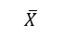
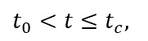
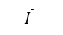
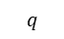
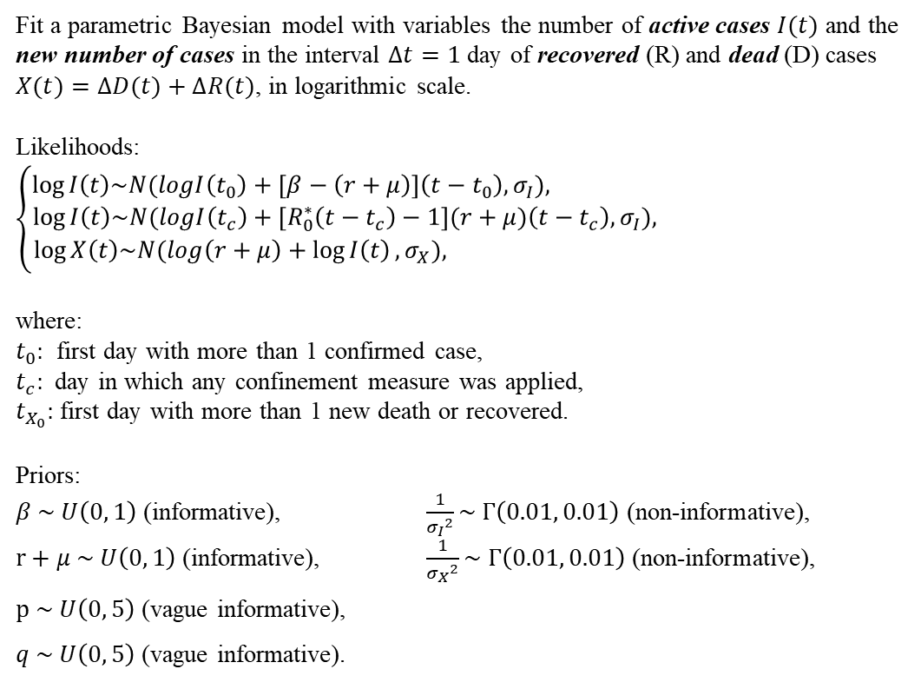
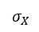
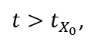
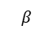
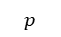
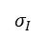
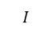
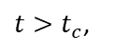
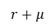
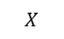
Fitting COVID-19 data
Fit a parametric Bayesian model with variables the number of active cases $I(t)$ and the new number of cases in the interval $∆t=1$ day of recovered (R) and dead (D) cases $X(t)=∆D(t)+∆R(t)$, in logarithmic scale.
Likelihoods:
$$\left\{\begin{aligned}\log{I\left(t\right)\sim N(logI\left(t_{0}\right)+\left[β−\left(r+μ\right)\right]\left(t−t_{0}\right), σ_{I}}), \\ \log{I\left(t\right)\sim N(logI\left(t_{c}\right)+\left[R_{0}^{∗}\left(t−t_{c}\right)−1\right](r+μ)\left(t−t_{c}\right), σ_{I}}), \\ \log{X\left(t\right)\sim N(log\left(r+μ\right)+\log{I\left(t\right)}, σ_{X}}), \end{aligned}\right.$$
where:
$t_{0}:$ first day with more than 1 confirmed case,
$t_{c}:$ day in which any confinement measure was applied,
$t_{X_{0}}:$ first day with more than 1 new death or recovered.
Priors:
$β \sim U\left(0, 1\right)$ (informative), $\frac{1}{{σ_{I}}^{2}}\sim Γ\left(0.01, 0.01\right)$ (non-informative),
$r+μ \sim U\left(0, 1\right)$ (informative), $\frac{1}{{σ_{X}}^{2}}\sim Γ\left(0.01, 0.01\right)$ (non-informative),
$p \sim U\left(0, 5\right)$ (vague informative),
$q \sim U\left(0, 5\right)$ (vague informative).
$$β$$
$σ_{I}$
$σ_{X}$
$$t_{0}<t≤t_{c},$$
$$r+μ$$
$$t>t_{c}\text{,}$$
$$I$$
$$\overline{I}$$
$$\overline{X}$$
$$X$$
$$t>t_{X_{0}}\text{,}$$
$$p$$
$$q$$
probabilistic distribution
deterministic function

Slide 7
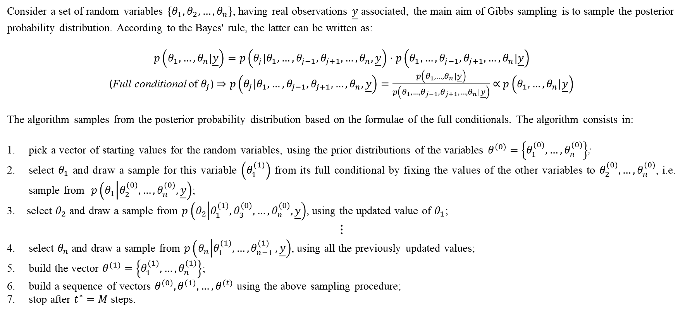
Gibbs sampler algorithm
Consider a set of random variables $\left\{θ_{1},θ_{2},…,θ_{n}\right\}$, having real observations $\underline{y}$ associated, the main aim of Gibbs sampling is to sample the posterior probability distribution. According to the Bayes' rule, the latter can be written as:
$$p\left(θ_{1},…,θ_{n}|\underline{y}\right)=p\left(θ_{j}|θ_{1},…,θ_{j−1},θ_{j+1},…,θ_{n}, \underline{y}\right)⋅p\left(θ_{1},…,θ_{j−1},θ_{j+1},…,θ_{n}|\underline{y}\right)$$
(Full conditional of $θ_{j}$) $⇒p\left(θ_{j}|θ_{1},…,θ_{j−1},θ_{j+1},…,θ_{n}, \underline{y}\right)=\frac{p\left(θ_{1},…,θ_{n}|\underline{y}\right)}{p\left(θ_{1},…,θ_{j−1},θ_{j+1},…,θ_{n}|\underline{y}\right)}∝$ $p\left(θ_{1},…,θ_{n}|\underline{y}\right)$
The algorithm samples from the posterior probability distribution based on the formulae of the full conditionals. The algorithm consists in:
pick a vector of starting values for the random variables, using the prior distributions of the variables $θ^{(0)}=\left\{θ_{1}^{(0)},…,θ_{n}^{(0)}\right\}$;
select $θ_{1}$ and draw a sample for this variable $\left(θ_{1}^{(1)}\right)$ from its full conditional by fixing the values of the other variables to $θ_{2}^{(0)},…,θ_{n}^{(0)}$, i.e. sample from $p\left(θ_{1} | θ_{2}^{(0)},…,θ_{n}^{(0)},\underline{y}\right)$;
3. select $θ_{2}$ and draw a sample from $p\left(θ_{2} | θ_{1}^{(1)},θ_{3}^{(0)},…,θ_{n}^{(0)},\underline{y}\right)$, using the updated value of $θ_{1}$;
⋮
select $θ_{n}$ and draw a sample from $p\left(θ_{n} | θ_{1}^{(1)},{…,θ}_{n−1}^{(1)},\underline{y}\right)$, using all the previously updated values;
build the vector $θ^{(1)}=\left\{θ_{1}^{(1)},…,θ_{n}^{(1)}\right\}$;
build a sequence of vectors $θ^{(0)},θ^{(1)}, …,θ^{(t)}$ using the above sampling procedure;
stop after $t^{∗}=M$ steps.

Slide 8
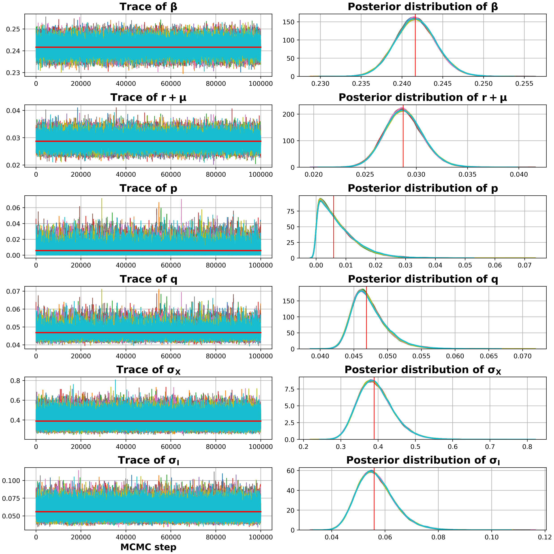
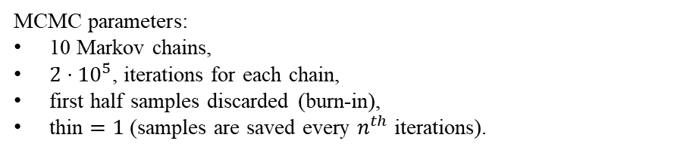
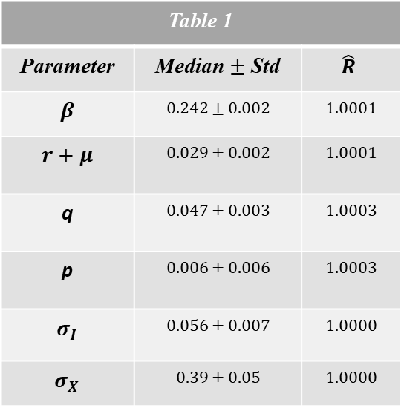
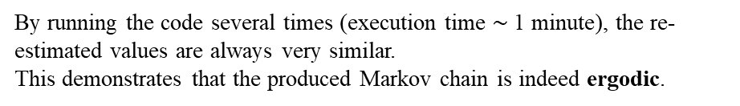
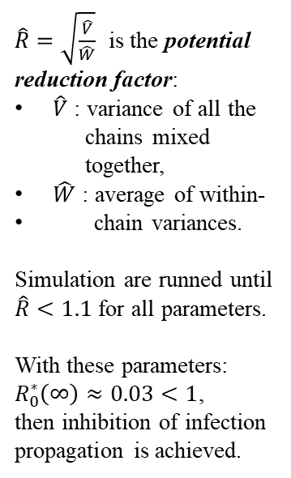
Fit results: before peak (first wave Italy)
MCMC parameters:
10 Markov chains,
${2̇⋅10}^{5}$, iterations for each chain,
first half samples discarded (burn-in),
thin $=1$ (samples are saved every $n^{th}$ iterations).
Table 1
Parameter | Median $±$ Std | $$\hat{R}$$
$$β$$ | $$0.242±0.002$$ | $$1.0001$$
$$r+μ$$ | $$0.029±0.002$$ | $$1.0001$$
q | $$0.047±0.003$$ | $$1.0003$$
p | $$0.006±0.006$$ | $$1.0003$$
$$σ_{I}$$ | $$0.056±0.007$$ | $$1.0000$$
$$σ_{X}$$ | $$0.39±0.05$$ | $$1.0000$$
$\hat{R}=\sqrt{\frac{\hat{V}}{\hat{W}}}$ is the potential reduction factor:
$\hat{V}$ : variance of all the
chains mixed
together,
$\hat{W}$ : average of within-
chain variances.
Simulation are runned until $\hat{R}<1.1$ for all parameters.
With these parameters:
$R_{0}^{∗}\left(∞\right)≈0.03<1$,
then inhibition of infection propagation is achieved.
By running the code several times (execution time $\sim$1 minute), the re-estimated values are always very similar.
This demonstrates that the produced Markov chain is indeed ergodic.

Slide 9
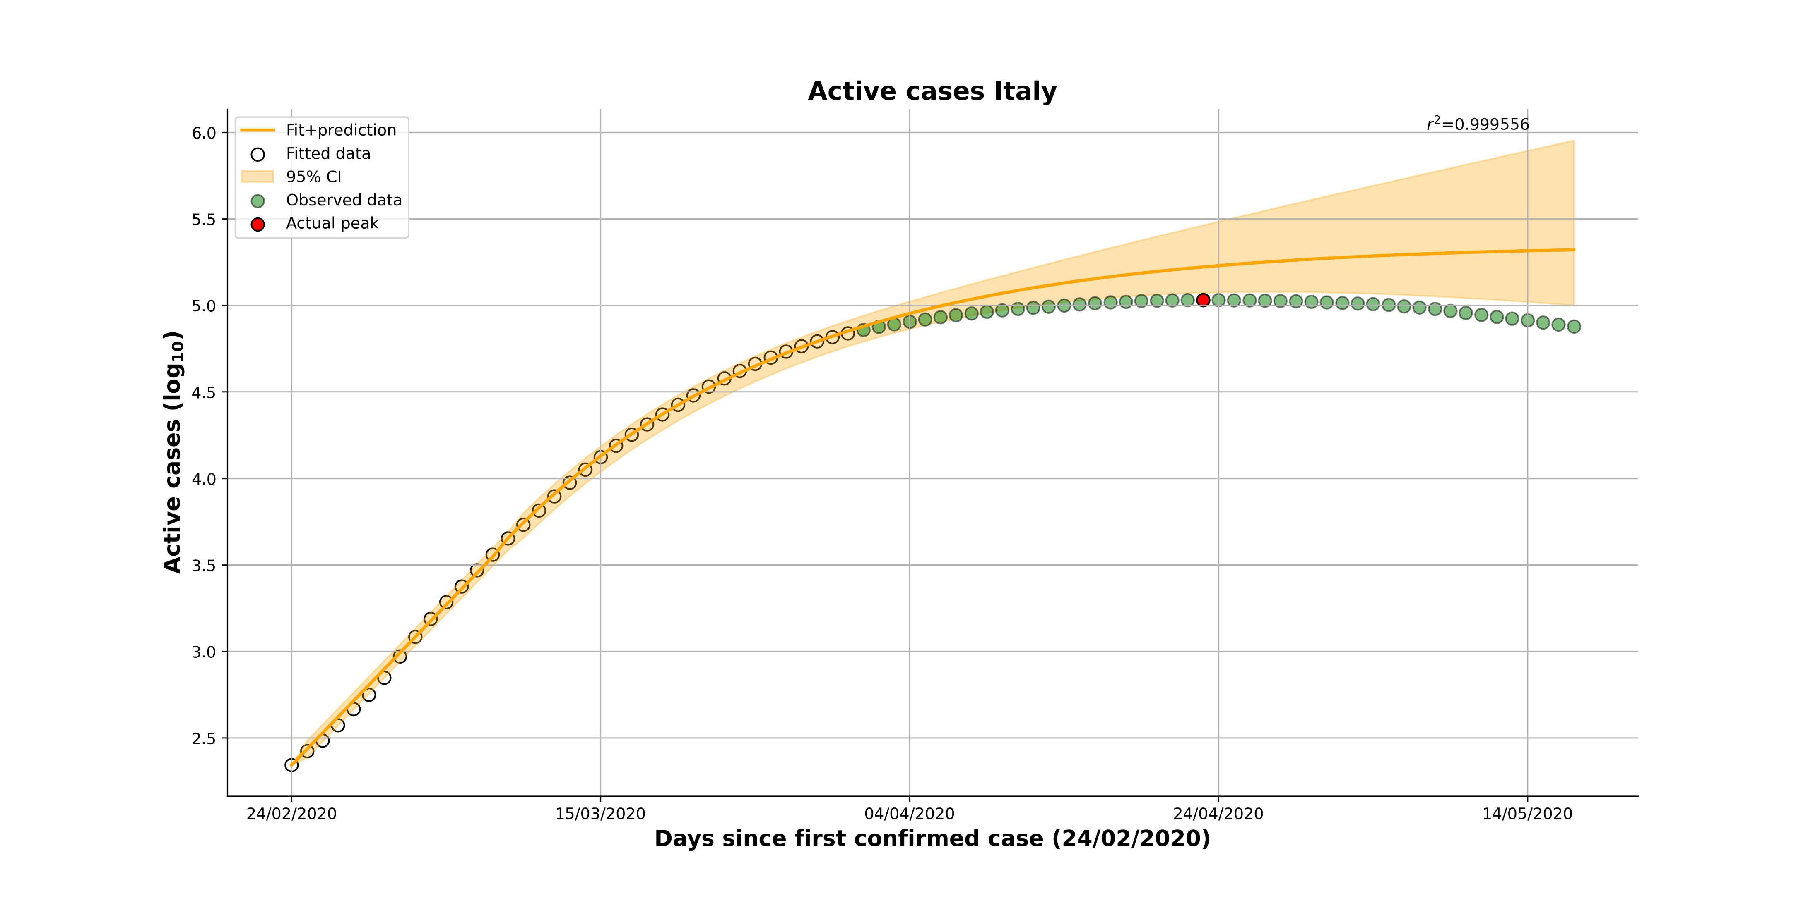
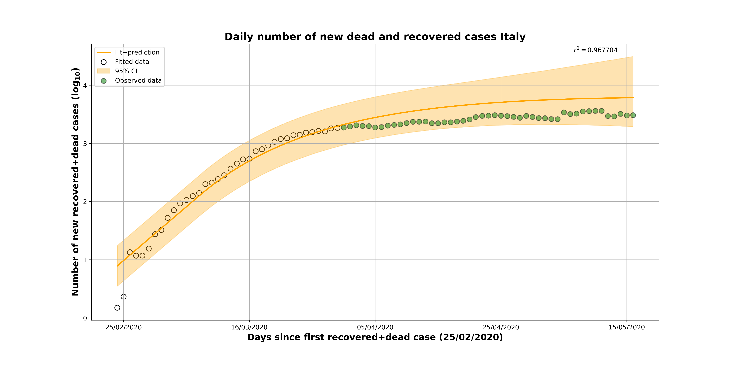
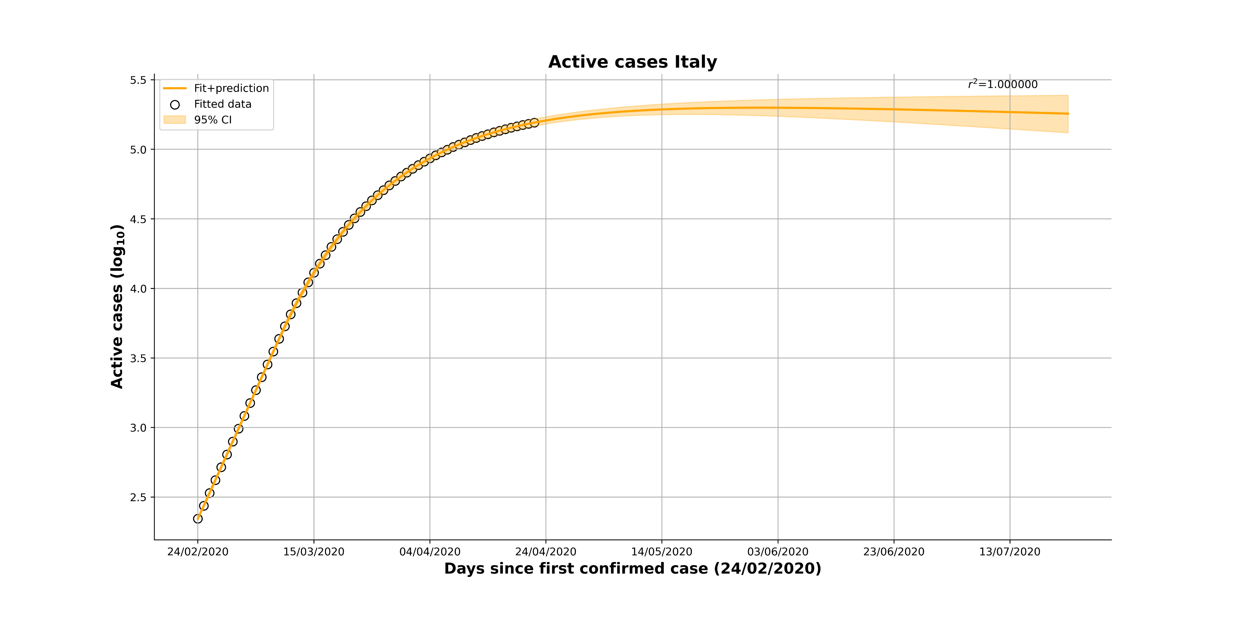
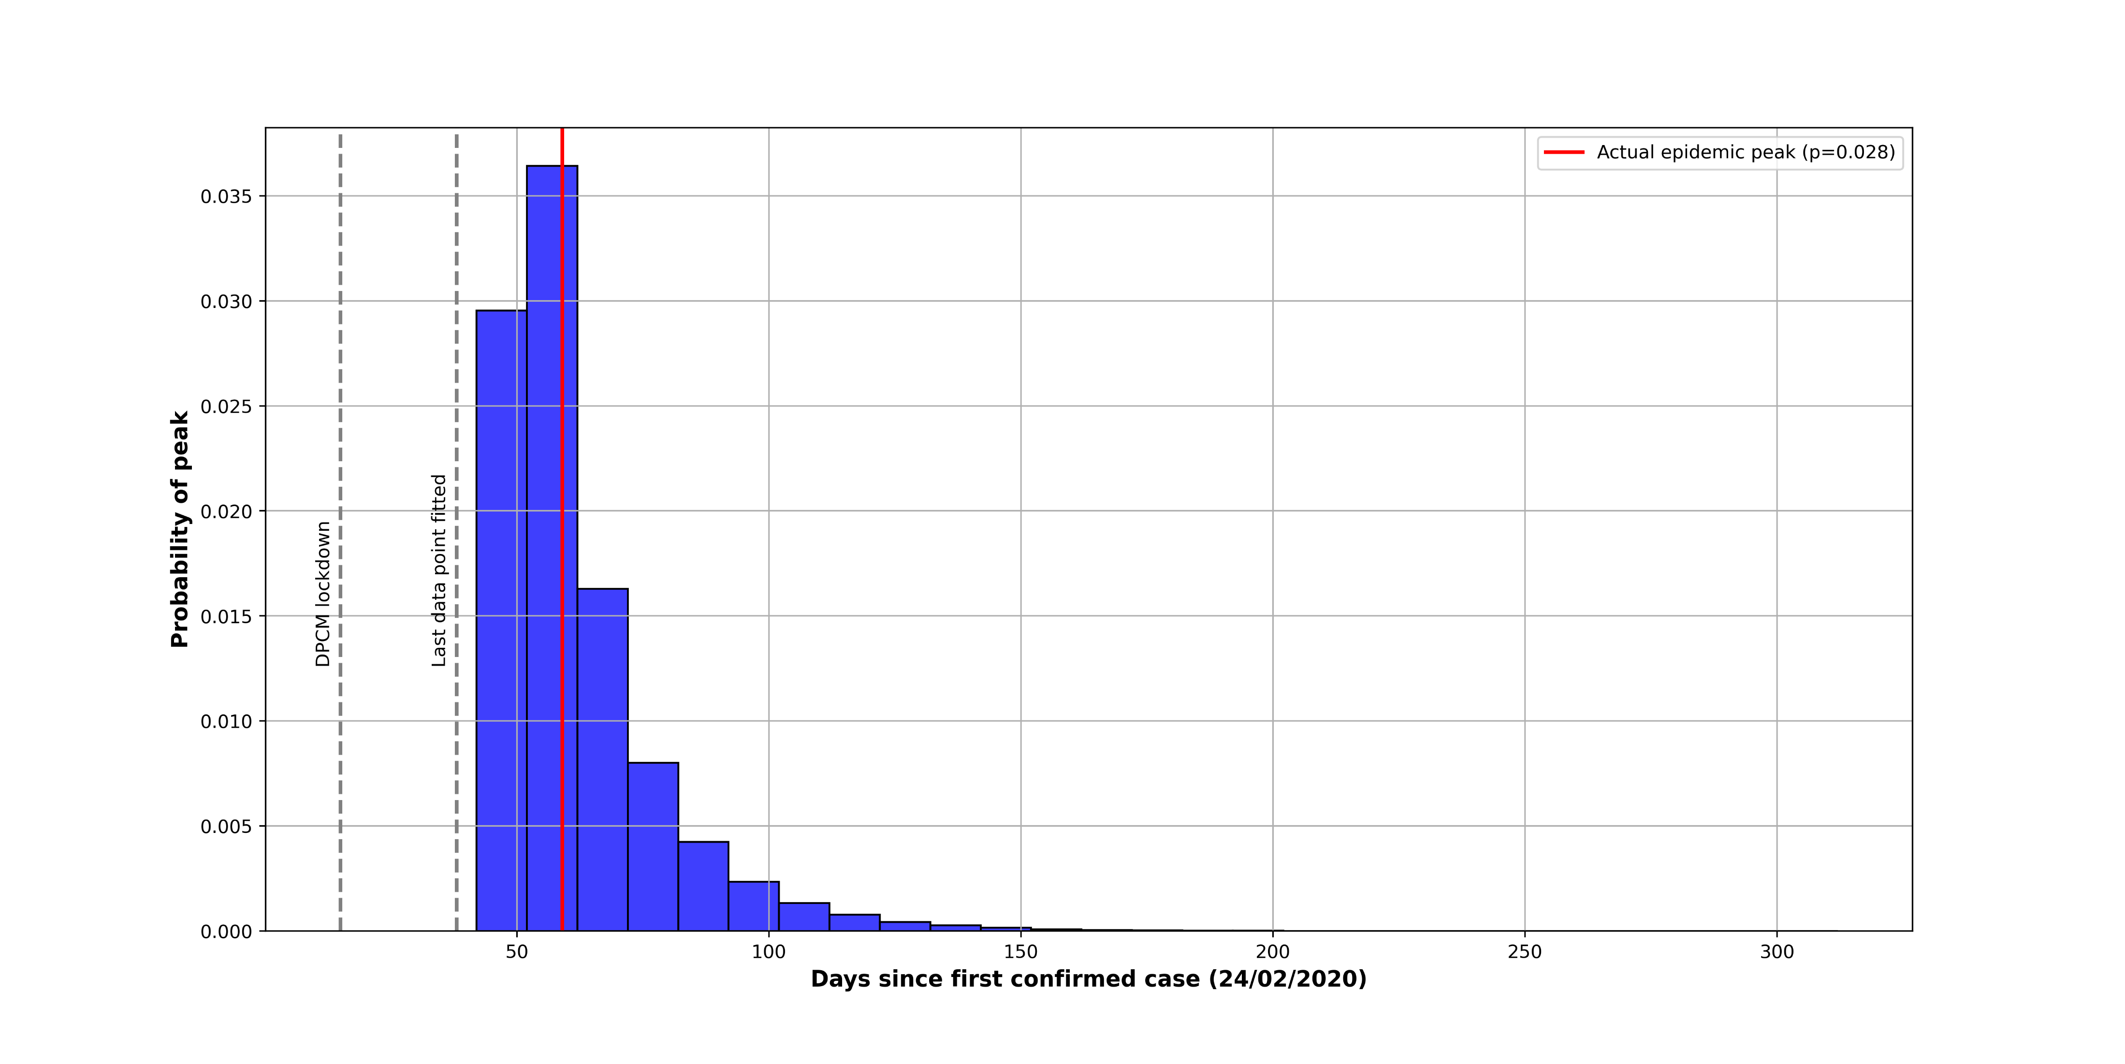
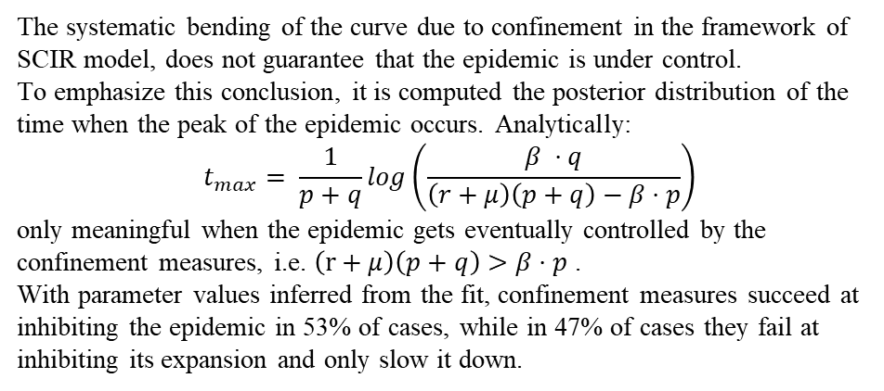
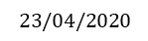
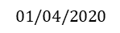
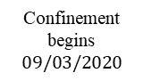
Fit results: before peak (first wave Italy)
$$01/04/2020$$
Exponential growth
Controlled epidemic
$$23/04/2020$$
Confinement begins
$$09/03/2020$$
The systematic bending of the curve due to confinement in the framework of SCIR model, does not guarantee that the epidemic is under control.
To emphasize this conclusion, it is computed the posterior distribution of the time when the peak of the epidemic occurs. Analytically:
$$t_{max}= \frac{1}{p+q}log\left(\frac{β ⋅q}{\left(r+μ\right)\left(p+q\right)−β⋅p}\right)$$
only meaningful when the epidemic gets eventually controlled by the confinement measures, i.e. $\left(r+μ\right)\left(p+q\right)>β⋅p$.
With parameter values inferred from the fit, confinement measures succeed at inhibiting the epidemic in 53% of cases, while in 47% of cases they fail at inhibiting its expansion and only slow it down.

Slide 10
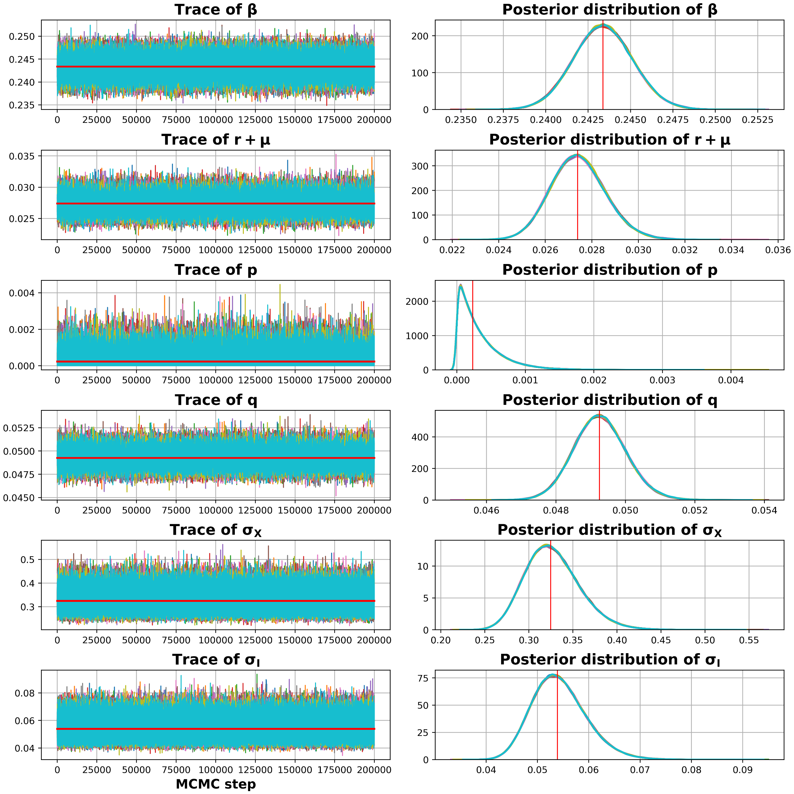



Fit results: until peak (first wave Italy)
MCMC parameters:
10 Markov chains,
${4⋅10}^{5}$, iterations for each chain,
first half samples discarded (burn-in),
thin $=1$ (samples are saved every $n^{th}$ iterations).
Table 2
Parameter | Median $±$ Std | $$\hat{R}$$
$$β$$ | $$0.243±0.002$$ | $$1.0001$$
$$r+μ$$ | $$0.027±0.001$$ | $$1.0001$$
q | $$0.0493±0.0008$$ | $$1.0001$$
p | $$0.0002±0.000\text{3}$$ | $$1.0000$$
$$σ_{I}$$ | $$0.054±0.005$$ | $$1.0000$$
$$σ_{X}$$ | $$0.32±0.03$$ | $$1.0000$$
By running the code several times (execution time $\sim$3 minutes), the re-estimated values are always very similar.
This demonstrates that the produced Markov chain is indeed ergodic.

Slide 11




Fit results: until peak (first wave Italy)
Distribution of times until the number of confirmed cases falls below 1200 for the first time. With about 2 cases for ${10}^{5}$ inhabitants, this threshold can define the end of the epidemic.
The distribution span about three months, centered around the end of October 2020 (31/10/2020).

Slide 12







Fit results: (second wave Italy)
$$25/11/2020$$
Confinement begins
$$06/11/2020$$
$$27/11/2020$$

Slide 13




Fit results: (second wave Italy)
Table 3
Parameter | Median $±$ Std | $$\hat{R}$$
$$β$$ | $0.0844±0.00$08 | $$1.0000$$
$$r+μ$$ | $$0.0147±0.0004$$ | $$1.0000$$
q | $$0.9±0.6$$ | $$1.0000$$
p | $$3±1$$ | $$1.0000$$
$$σ_{I}$$ | $$0.053±0.007$$ | $$1.0000$$
$$σ_{X}$$ | $$0.14±0.02$$ | $$1.0000$$
Table 4
Parameter | Median $±$ Std | $$\hat{R}$$
$$β$$ | $$0.0869±0.0009$$ | $$1.0000$$
$$r+μ$$ | $$0.0172±0.0007$$ | $$1.0000$$
q | $$0.09±0.02$$ | $$1.0000$$
p | $$0.04±0.03$$ | $$1.0000$$
$$σ_{I}$$ | $$0.044±0.005$$ | $$1.0000$$
$$σ_{X}$$ | $$0.38±0.03$$ | $$1.0000$$
About fit results:
in both cases the past data are fitted perfectly;
there have been many dpcm before that of 06/11/2020 (yellow, orange, red zones), thus the confinement measures were not applied in the same way in all regions;
as an example, due to the regional-level system of Italian healthcare, data are collected at a regional level and then reported to the National level via the Pro-tezione Civile transferring them to WHO. These processes could be affected by some inconsistencies and delays, especially dur-ing the most critical phase of the epidemic diffusion that could introduce errors into the daily data.
the fact that in most cases the progress of the epidemic is not controlled means that further measures must be taken;
With the parameters in Table 3:
$R_{0}^{∗}\left(∞\right)≈4.53>1$,
then the epidemic is not controlled.
Fit before peak:
confinement measures succeed at inhibiting the epidemic only in 0.06% of cases.
With the parameters in Table 4:
$R_{0}^{∗}\left(∞\right)≈1.62>1$,
then the epidemic is not controlled.
Fit until peak:
confinement measures succeed at inhibiting the epidemic only in 18% of cases.

Slide 14






Results: first wave on other countries (Spain)
2° confinement begins
$$30/03/2020$$
$$23/04/2020$$
1° confinement begins
$$11/03/2020$$

Slide 15







Results: first wave on other countries (Spain)
Table 5
Parameter | Median $±$ Std | $$\hat{R}$$
$$β$$ | $0.370±0.00$8 | $$1.0000$$
$$r+μ$$ | $$0.020±0.005$$ | $$1.0000$$
q | $$0.055±0.005$$ | $$1.0000$$
p | $$0.007±0.009$$ | $$1.0000$$
$$σ_{I}$$ | $$0.13±0.02$$ | $$1.0000$$
$$σ_{X}$$ | $$1.1±0.2$$ | $$1.0000$$
Table 6
Parameter | Median $±$ Std | $$\hat{R}$$
$$β$$ | $$0.397±0.007$$ | $$1.0000$$
$$r+μ$$ | $$0.032±0.006$$ | $$1.0000$$
q | $$0.060±0.002$$ | $$1.0000$$
p | $$0.004±0.005$$ | $$1.0000$$
$$σ_{I}$$ | $$0.14±0.02$$ | $$1.0000$$
$$σ_{X}$$ | $$1.0±0.1$$ | $$1.0000$$
With the parameters in Table 5:
$R_{0}^{∗}\left(∞\right)≈2.00>1$,
then the epidemic is not controlled.
With the parameters in Table 6:
$R_{0}^{∗}\left(∞\right)≈0.07<1$,
then the epidemic is controlled.
fit before peak:
confinement measures succeed at inhibiting the epidemic only in 27% of cases.
fit until peak:
confinement measures succeed at inhibiting the epidemic only in 99% of cases.
Distribution of times until the number of confirmed cases falls below 1000 (2 cases for ${10}^{5}$ inhabitants) for the first time. The distribution span about three months, centered around the half of October 2020 (15/10/2020).

Slide 16







Results: second wave on other countries (France)
$$10/11/2020$$
Confinement begins
$$28/10/2020$$
$$22/11/2020$$

Slide 17




Fit results: (second wave Italy)
Table 3
Parameter | Median $±$ Std | $$\hat{R}$$
$$β$$ | $0.0281±0.00$07 | $$1.0000$$
$$r+μ$$ | $0.00070±0.000$01 | $$1.0000$$
q | $$0.03±0.06$$ | $$1.0000$$
p | $$3±1$$ | $$1.0000$$
$$σ_{I}$$ | $$0.053±0.007$$ | $$1.0000$$
$$σ_{X}$$ | $$0.20±0.02$$ | $$1.0000$$
Table 4
Parameter | Median $±$ Std | $$\hat{R}$$
$$β$$ | $$0.0284±0.0005$$ | $$1.0000$$
$$r+μ$$ | $$0.00080±0.00001$$ | $$1.0000$$
q | $$0.03±0.04$$ | $$1.0000$$
p | $$3±1$$ | $$1.0000$$
$$σ_{I}$$ | $$0.050±0.005$$ | $$1.0000$$
$$σ_{X}$$ | $$0.20±0.02$$ | $$1.0000$$
With the parameters in Table 3:
$R_{0}^{∗}\left(∞\right)≈39>1$,
then the epidemic is not controlled.
Fit before peak:
confinement measures succeed at inhibiting the epidemic only in 0.06% of cases.
With the parameters in Table 4:
$R_{0}^{∗}\left(∞\right)≈38>1$,
then the epidemic is not controlled.
Fit until peak:
confinement measures succeed at inhibiting the epidemic only in 18% of cases.

Slide 18
Conclusion
The simple model used, illustrates how lockdown measures inhibit infection spread only above a threshold;
a Bayesian fit to the COVID-19 pandemic shows that a slowdown in the number of newly infected individuals during the expansion phase allows one to infer neither the precise position of the maximum nor whether the measures taken will bring the propagation to the inhibition regime;
there is a short horizon for reliable prediction, followed by a dispersion of the possible trajectories that grows extremely fast. The impossibility to predict in the midterm is not due to wrong or incomplete data, since it persists in error-free, synthetically produced datasets and does not necessarily improve using larger datasets;
uncertainties in the values of the latter prevent a unique interpretation of the data at the transient.

Slide 19


References
COVID-19 data for Italy:
https://raw.githubusercontent.com/pcm-dpc/COVID-19/master/dati-andamento-nazionale/dpc-covid19-ita-andamento-nazionale.csv
COVID-19 data for Spain and France:
https://github.com/CSSEGISandData/COVID-19/tree/master/csse_covid_19_data/csse_covid_19_time_series
M. Castro et al. "The turning point and end of an expanding epidemic cannot be precisely forecast"

Slide 21




Fit results: before peak (2° wave Italy)
MCMC parameters:
10 Markov chains,
${4⋅10}^{5}$, iterations for each chain,
first half samples discarded (burn-in),
thin $=1$ (samples are saved every $n^{th}$ iterations).
By running the code several times (execution time $\sim 3$ minutes), the re-estimated values are always very similar.
This demonstrates that the produced Markov chain is indeed ergodic.
Table 3
Parameter | Median $±$ Std | $$\hat{R}$$
$$β$$ | $0.0844±0.00$08 | $$1.0000$$
$$r+μ$$ | $$0.0147±0.0004$$ | $$1.0000$$
q | $$0.9±0.6$$ | $$1.0000$$
p | $$3±1$$ | $$1.0000$$
$$σ_{I}$$ | $$0.053±0.007$$ | $$1.0000$$
$$σ_{X}$$ | $$0.14±0.02$$ | $$1.0000$$
With the parameters in Table 3:
$R_{0}^{∗}\left(∞\right)≈4.53<1$,
then the epidemic is not controlled.

Slide 22




Fit results: until peak (2° wave Italy)
MCMC parameters:
10 Markov chains,
${4⋅10}^{5}$, iterations for each chain,
first half samples discarded (burn-in),
thin $=1$ (samples are saved every $n^{th}$ iterations).
By running the code several times (execution time $\sim$3 minutes), the re-estimated values are always very similar.
This demonstrates that the produced Markov chain is indeed ergodic.
Table 4
Parameter | Median $±$ Std | $$\hat{R}$$
$$β$$ | $$0.0869±0.0009$$ | $$1.0000$$
$$r+μ$$ | $$0.0172±0.0007$$ | $$1.0000$$
q | $$0.09±0.02$$ | $$1.0000$$
p | $$0.04±0.03$$ | $$1.0000$$
$$σ_{I}$$ | $$0.044±0.005$$ | $$1.0000$$
$$σ_{X}$$ | $$0.38±0.03$$ | $$1.0000$$
With the parameters in Table 4:
$R_{0}^{∗}\left(∞\right)≈1.62<1$,
then the epidemic is not controlled.

Slide 23


Results: first wave on other countries (Spain)

Slide 24

Obtaining analytical forms of full conditionals
write the complete formula of the posterior probability;
pick one parameter $θ_{i}$;
from the formula of the posterior probability, drop all the factors that do not depend on $θ_{i}$;
at this point, if the other parameters are fixed to their current values, a formula for the full conditional of $θ_{i}$ is obtained;
use automatic simplification procedures to figure out if the conditional probability can be reduced to a known statistical distribution;
repeat step 2-5 for all the parameters.

Slide 25

Gibbs sampling correctness
The Gibbs sampler produces a Markov chain of samples, because at each step it estimates each variable using values of the other variables either at the previous time instant or at the current time instant. Indeed, for a set of variables $\left\{θ_{1}, …,θ_{n}\right\}$ the Gibbs sampler builds the following transition probabilities distributions
$$p_{t}\left(θ_{i}^{(t)}|θ_{1}^{\left(1\right)},…,θ_{i−1}^{\left(t\right)},θ_{i+1}^{\left(t−1\right)},…,θ_{n}^{\left(t−1\right)},\overline{y}\right)$$
which are transition probability distributions of a Markov chain.

